Slide 1
Relational Database Design

Slide 2
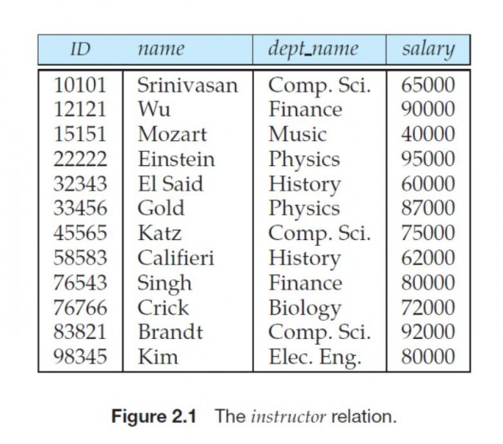

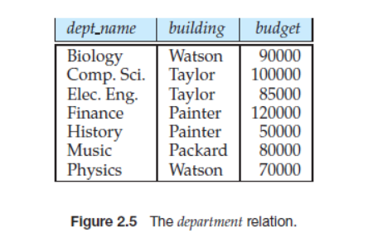
Combine Schemas?
Suppose we combine instructor and department into inst_dept
  (No connection to relationship set inst_dept)
Result is possible repetition of information
inst_dept Relation

Slide 3
A Combined Schema Without Repetition
Consider combining relations
  1. sec_class(sec_id, building, room_number) and
  2. section(course_id, sec_id, semester, year)
  into one relation
  section(course_id, sec_id, semester, year,
  building, room_number)
    No repetition in this case

Slide 4

A Lossy Decomposition
Not all decompositions are good. Suppose we decompose,
employee(ID, name, street, city, salary) into
employee1 (ID, name)
employee2 (name, street, city, salary)
we cannot reconstruct the original employee relation

Slide 5
Example of Lossless-Join Decomposition
Lossless join decomposition
Decomposition of R = (A, B, C)
R₁ = (A, B) R₂ = (B, C)
A
B
C
A
B
B
C
α
β
1
2
A
B
α
β
1
2
1
2
A
B
r
∏_{A,B}(r)
∏_{B,C}(r)
∏_{A} (r) ∏_{B} (r)
A
B
C
α
β
1
2
A
B

Slide 6
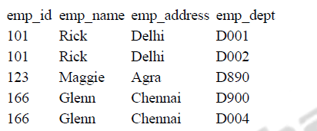
ANOMALY
Update anomaly:
In the above table we have two rows for employee Rick as he belongs to two departments of the company.
If we want to update the address of Rick then we have to update the same in two rows or the data will become inconsistent.
If somehow, the correct address gets updated in one department but not in other then as per the database, Rick would be having two different addresses, which is not correct and would lead to inconsistent data.

Slide 7
ANOMALY
Delete anomaly:
Suppose, if at a point of time the company closes the department D890 then deleting the rows that are having emp_dept as D890 would also delete the information of employee Maggie since she is assigned only to this department.

Slide 8
Anomaly
Insert anomaly:
Suppose a new employee joins the company, who is under training and currently not assigned to any department then we would not be able to insert the data into the table if emp_dept field doesn’t allow nulls.
To overcome these anomalies we need to normalize the data.

Slide 9
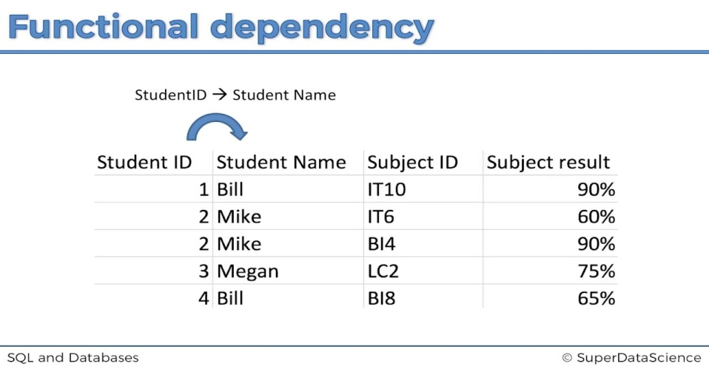
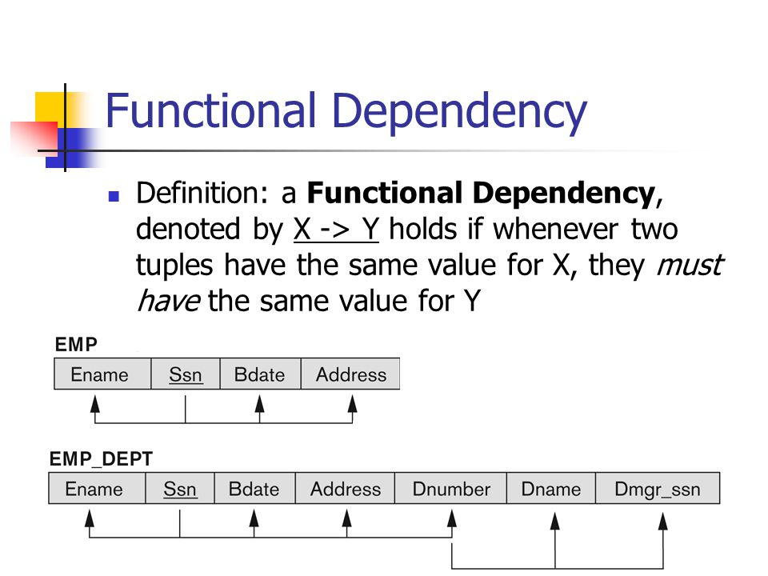
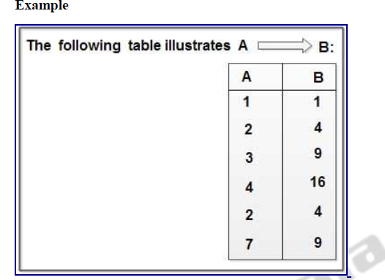
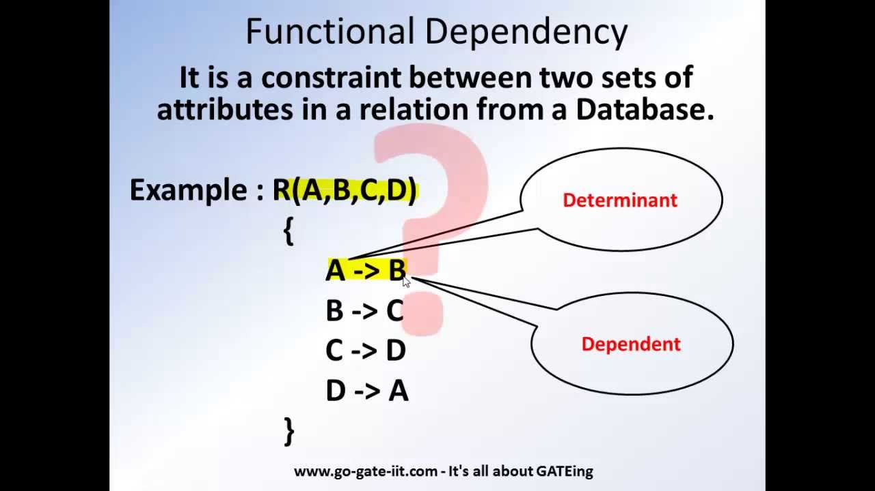
Functional Dependency

Slide 10
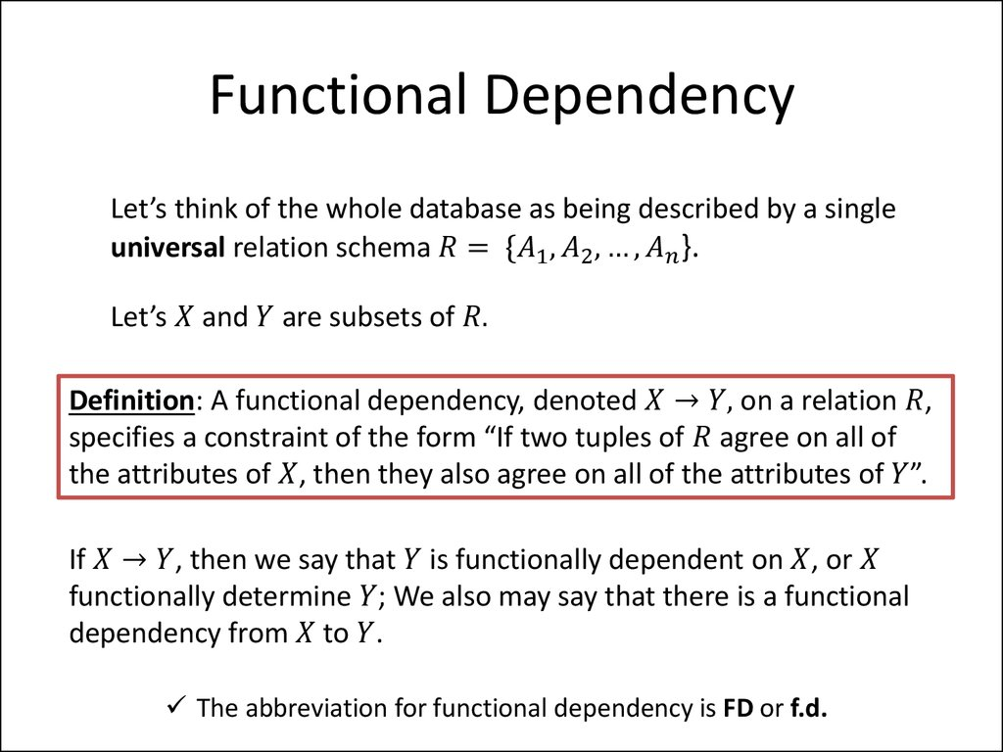

Slide 11
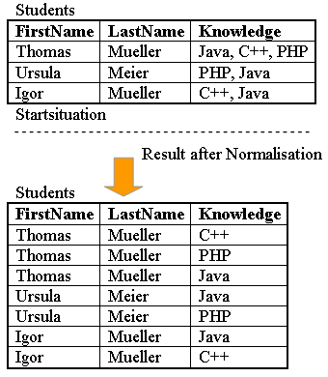
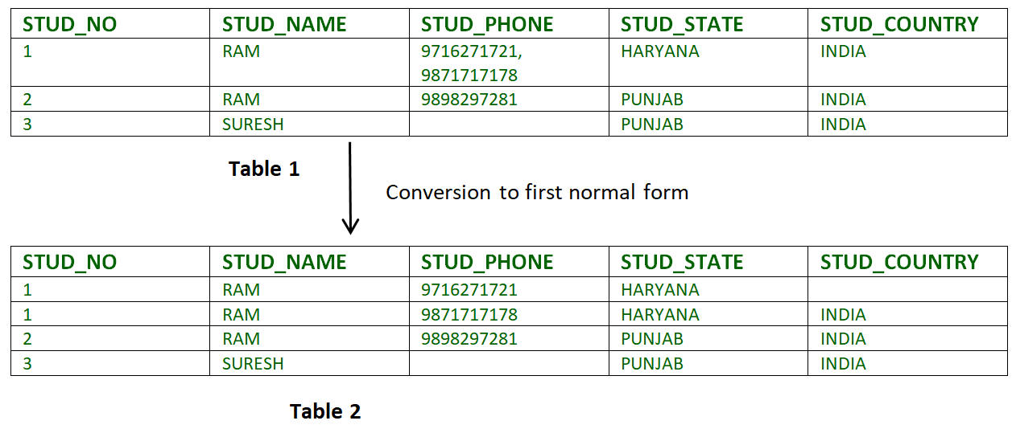
First Normal Form
If a relation contain composite or multi-valued attribute, it violates first normal form or a relation is in first normal form if it does not contain any composite or multi-valued attribute.
A relation is in first normal form if every attribute in that relation is singled valued attribute.

Slide 12
Second Normal Form
To be in second normal form, a relation must be in first normal form and relation must not contain any partial dependency.
A relation is in 2NF if it has No Partial Dependency, i.e., no non-prime attribute (attributes which are not part of any candidate key) is dependent on any proper subset of any candidate key of the table.
Partial Dependency – If the proper subset of candidate key determines non-prime attribute, it is called partial dependency.

Slide 13
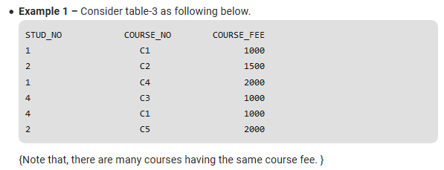
Here,
COURSE_FEE cannot alone decide the value of COURSE_NO or STUD_NO;
{COURSE_FEE = 2000 -> C4 & 1 , C5 & 2}
COURSE_FEE together with STUD_NO cannot decide the value of COURSE_NO;
{COURSE_FEE together with STUD_NO = 1000, 4 -> C3}
{COURSE_FEE together with STUD_NO = 1000, 4 -> C1}
COURSE_FEE together with COURSE_NO cannot decide the value of STUD_NO;
{COURSE_FEE together with COURSE_NO = 1000, C1 -> 1}
{COURSE_FEE together with COURSE_NO = 1000, C1 -> 4}
Hence,
COURSE_FEE would be a non-prime attribute, as it does not belong to the one only candidate key {STUD_NO, COURSE_NO} ;

Slide 14
But, COURSE_NO -> COURSE_FEE ,
i.e., COURSE_FEE is dependent on COURSE_NO, which is a proper subset of the candidate key.
Non-prime attribute COURSE_FEE is dependent on a proper subset of the candidate key, which is a partial dependency and so this relation is not in 2NF.

Slide 15
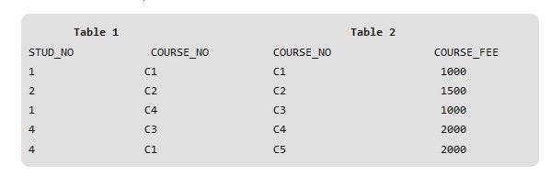
To convert the above relation to 2NF, we need to split the table into two tables such as :
Table 1: STUD_NO, COURSE_NO
Table 2: COURSE_NO, COURSE_FEE
NOTE: 2NF tries to reduce the redundant data getting stored in memory. For instance, if there are 100 students taking C1 course, we don’t need to store its Fee as 1000 for all the 100 records, instead once we can store it in the second table as the course fee for C1 is 1000.

